Slide 1

PromptCraft AI
Human-in-the-Loop Prompt Engineering
Submitted by: Gopal Kaushik (UID: 25BCS80003)
Class: B.E. CSE (LEET)
Course: Generative AI & Prompt Engineering
Instructor: Er. Simranjeet Kour
University: Chandigarh University

Slide 2



The Blank Canvas Problem
Generative AI offers immense potential, yet users frequently encounter the "Blank Canvas Problem". This arises when initial, vague inputs lead to uninspired or even erroneous outputs from the AI.
Garbage In, Garbage Out
Unclear or poorly structured inputs inevitably result in generic or "hallucinated" AI responses, undermining reliability.
Lack of Prompt Engineering Skills
Most users lack the nuanced skills required for effective prompt engineering, such as providing precise context, defining personas, or establishing critical constraints.

Slide 3



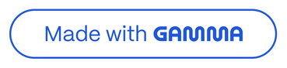
Introducing PromptCraft AI
PromptCraft AI acts as an intelligent middleware, bridging the gap between user intent and powerful Large Language Models (LLMs). It transforms raw ideas into highly effective system prompts.
Intelligent Translator
Converts natural, often vague, user queries into structured, professional-grade prompts for optimal AI interaction.
Refine-Review-Execute
Our core workflow ensures user oversight and iterative improvement, guaranteeing relevant and accurate AI outputs.

Slide 4
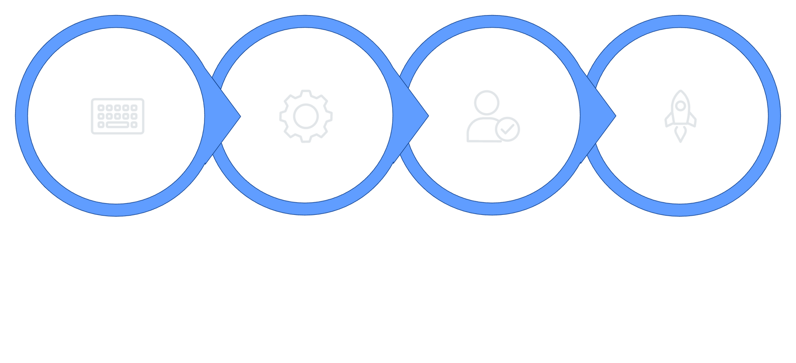




System Workflow: How it Works
User Input
Refiner Agent
User Review
Final Execution
PromptCraft AI meticulously refines each request through a structured, human-centric process to achieve precision and relevance.
User Input
Refiner Agent
Users articulate raw, often vague, ideas or requests to the system.
A specialised Gemini 1.5 Flash agent employs meta-prompts to optimise and expand the initial user input.
User Review
Final Execution
The human-in-the-loop verifies and fine-tunes the refined prompt before execution, ensuring alignment with intent.
The now-optimised prompt is sent to the LLM, yielding superior and precise results.

Slide 5
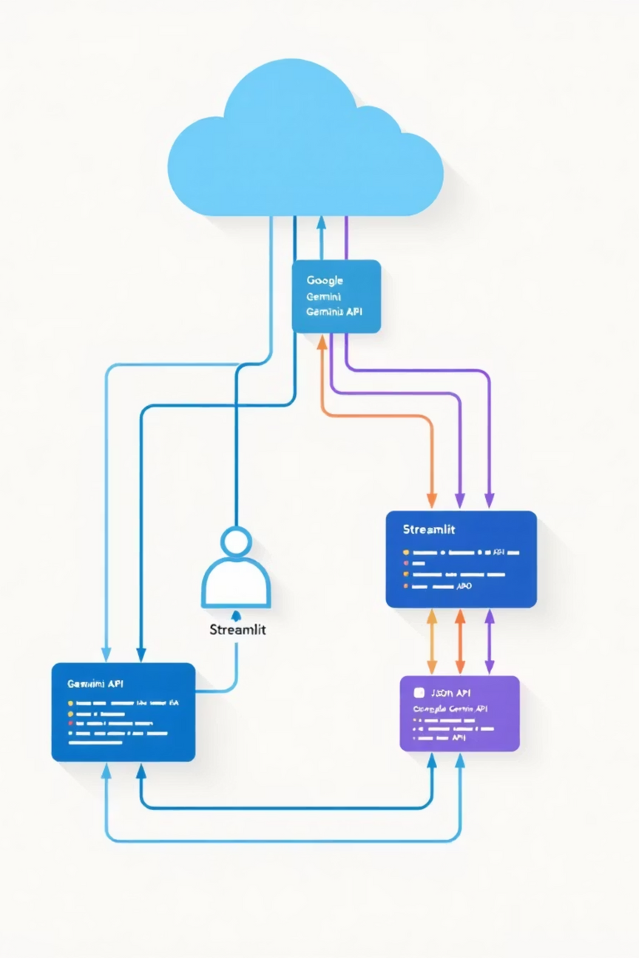



System Architecture
PromptCraft AI operates on a robust client-server model, ensuring efficient and secure interactions between users and the underlying AI.
User Browser
The user interface, accessible via any modern web browser, initiates all interactions.
Streamlit Server (Python)
Manages user sessions, processes requests, and orchestrates communication with the AI model.
Google Gemini API
Facilitates access to the powerful Gemini 1.5 Flash model for prompt refinement.
Data Layer: Utilises JSON-based local storage for persistence of user interaction history.

Slide 6
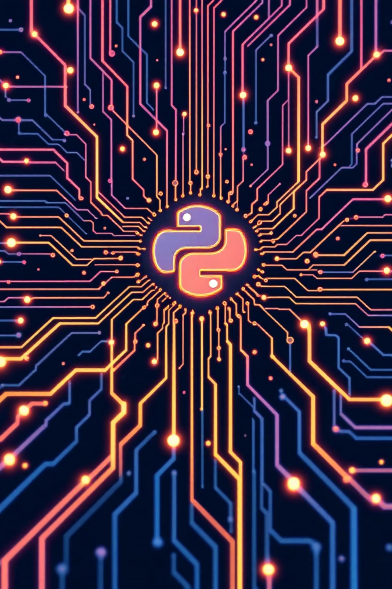
Technology Stack
PromptCraft AI is built upon a modern and efficient technology stack, leveraging industry-leading tools for performance and scalability.
Programming Language
AI Model
Python 3.10: The backbone of the application, chosen for its versatility and extensive AI libraries.
Google Gemini 1.5 Flash (via API): Powers the intelligent Refiner Agent for advanced prompt optimisation.
Frontend
Tools & Libraries
Streamlit: Rapid application development for interactive web UIs, enhanced with Custom CSS for a Cyber-Glass aesthetic.
Python-Dotenv (Security) for environment variable management and JSON (Persistence) for data storage.

Slide 7
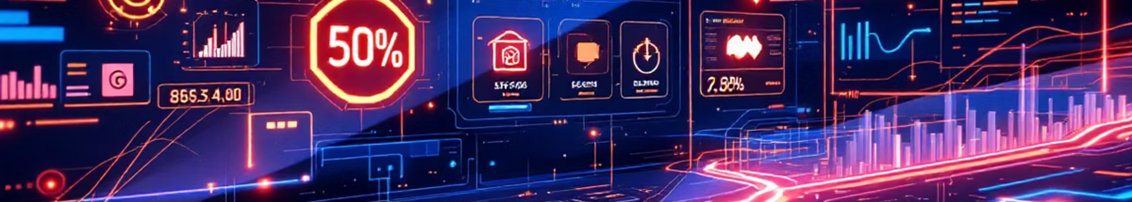



Key Features
PromptCraft AI incorporates several innovative features designed to enhance user experience and interaction with Generative AI.
Automated Refinement
Smart Avatars
History Persistence
An expert AI agent automatically rewrites and optimises user queries, injecting necessary context and detail.
Dynamically changing icons provide visual cues based on the prompt's context (e.g., 👨‍💻 for code, 📊 for data analysis).
All interactions are automatically saved, preventing data loss and allowing users to revisit previous chats and refinements.

Slide 8
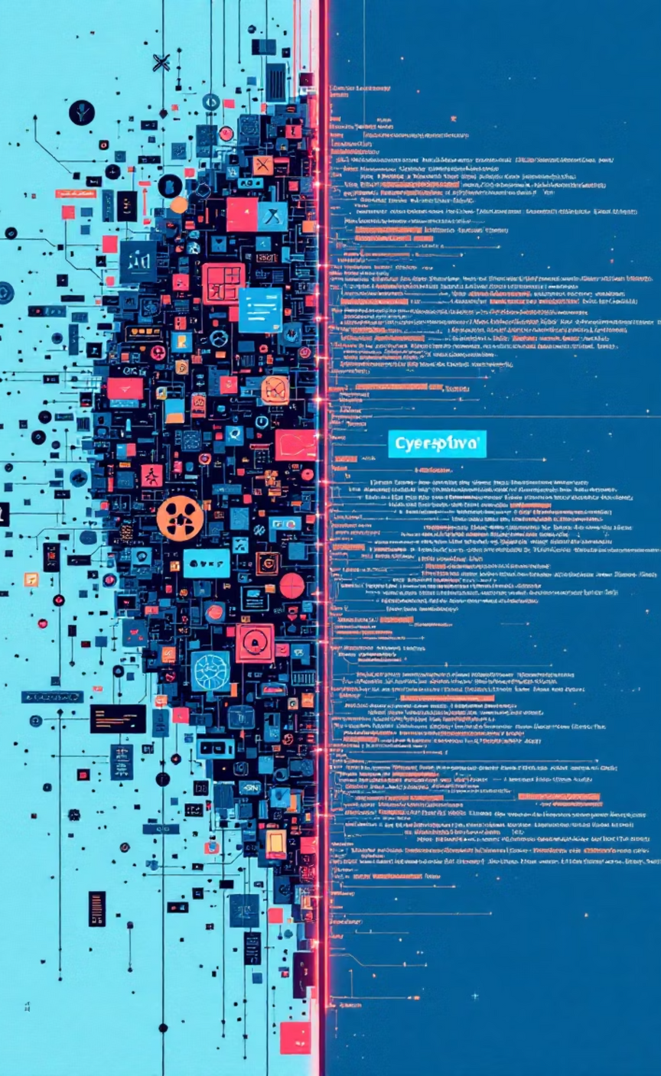
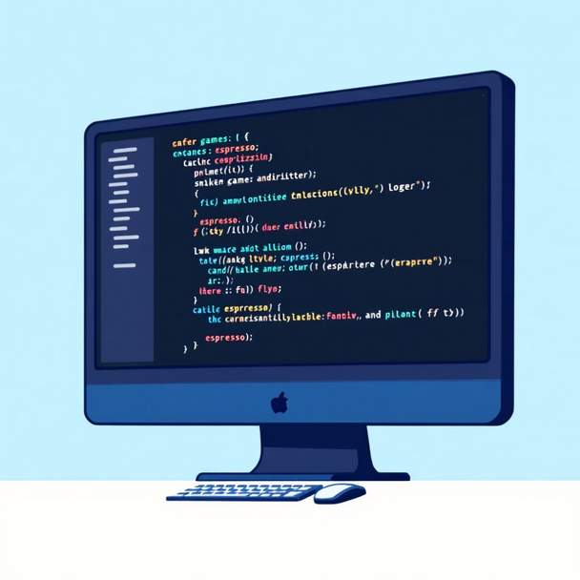
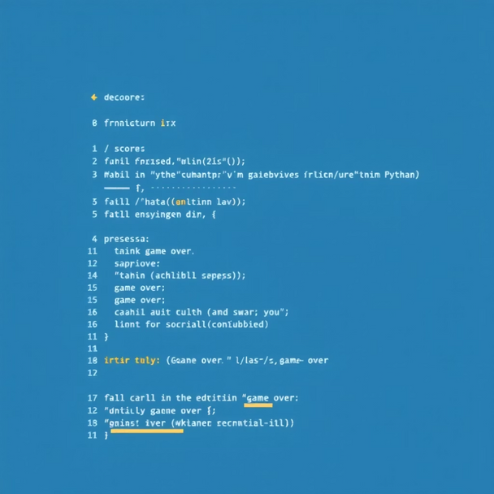
Results & Comparison
Observe the transformative impact of PromptCraft AI in generating superior and actionable AI outputs compared to raw inputs.
Before PromptCraft AI
After PromptCraft AI
Input: "Snake game"
Input: "Snake game"
Result: A generic, often incomplete, code snippet for a basic snake game, lacking essential features or specific implementation details.
Refined Prompt: "Create a fully functional Python Snake game using Pygame with scoring and game-over logic."
Result: Perfect, working code for a complete Snake game, including specified features, directly runnable and robust.

Slide 9

Future Scope
The development of PromptCraft AI continues with exciting plans to integrate advanced functionalities, further enhancing its utility and accessibility.
Voice Interaction
Multi-Modal Support
Integrating sophisticated Speech-to-Text capabilities for hands-free and more intuitive prompt generation.
Enabling Image-to-Text inputs, allowing users to describe prompts visually and expand the AI's understanding.
Community Prompt Library
A centralised platform for users to save, share, and discover effective prompts, fostering collaborative innovation.

Slide 10

Conclusion
PromptCraft AI demonstrates that integrating human oversight with advanced AI is paramount for achieving reliable and high-quality Generative AI outcomes.
Empowering Reliability
Human-in-the-loop workflows are not merely an enhancement; they are fundamental to unlocking the true potential and ensuring the consistent reliability of Generative AI systems.
Thank You.

